Slide 1

What to expect in
Year 2

Slide 2


Slide 3
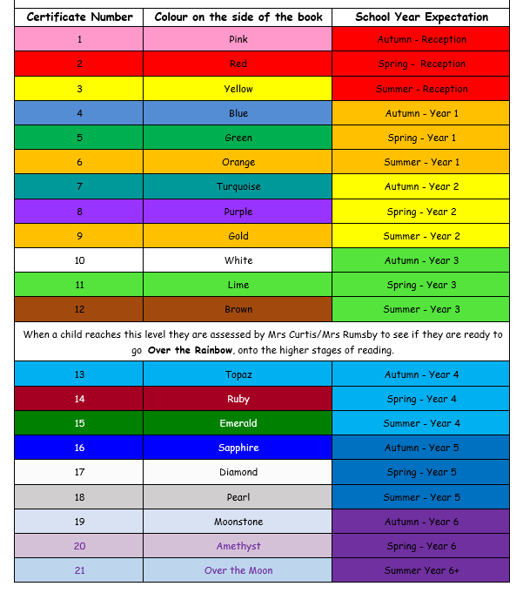
Reading by year

Slide 4
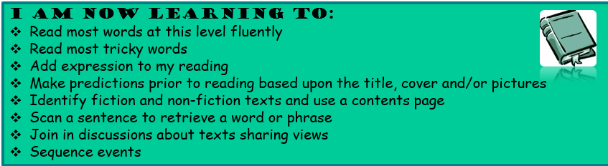
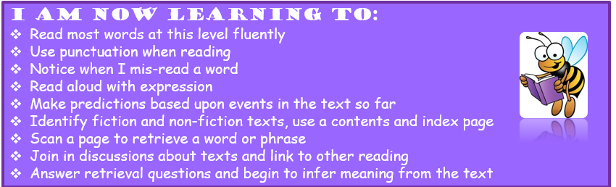
Reading in Year 2

Slide 5
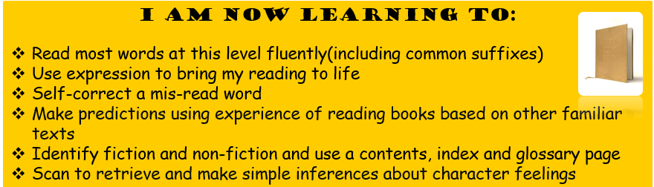

Slide 6

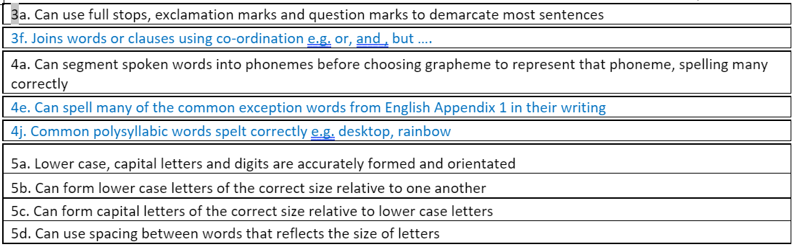
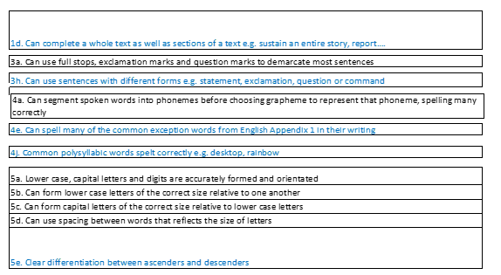

AUTUMN 1
Instructions, story writing based on Pirate story
Writing
AUTUMN 2
Diary based on the story Tuesday, Recount, Nativity, Poem

Slide 7

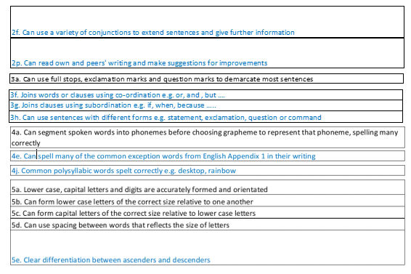
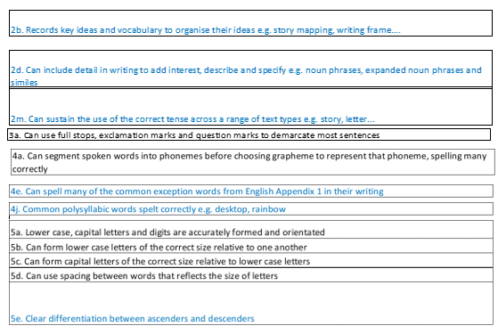


SPRING 1
Non-chronological report- castles, Character description - Troll
SPRING 2
Story with a Familiar Setting- The Magic Paintbrush,
A letter, Recount

Slide 8

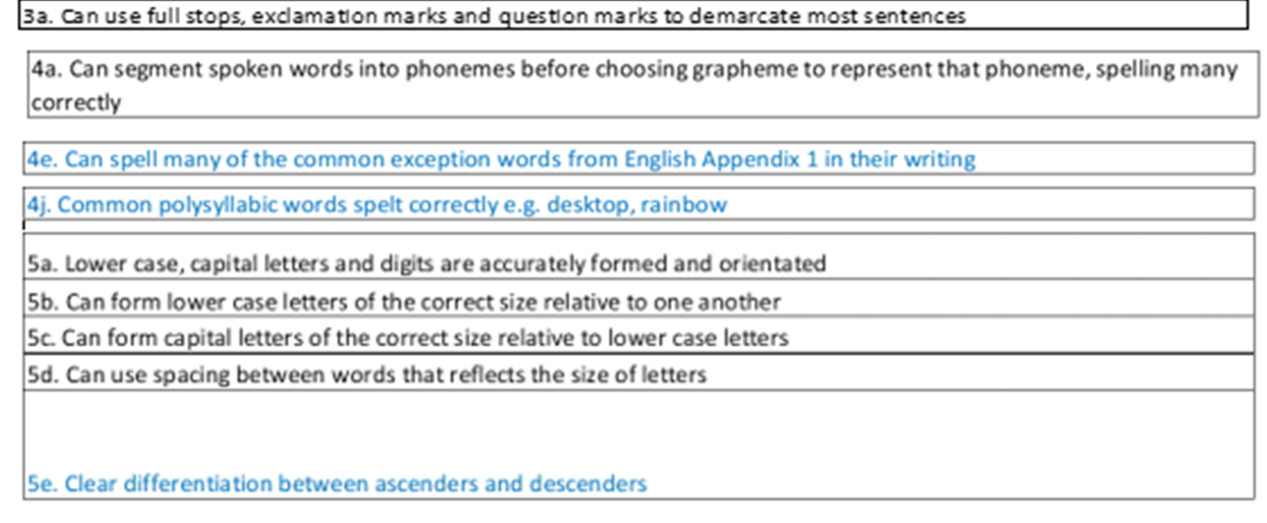


SUMMER 1
Alternative tale - Little Red Reading Hood, poem
Writing
SUMMER 2
Narrative - under the sea story, Animal fact file, Recount

Slide 9
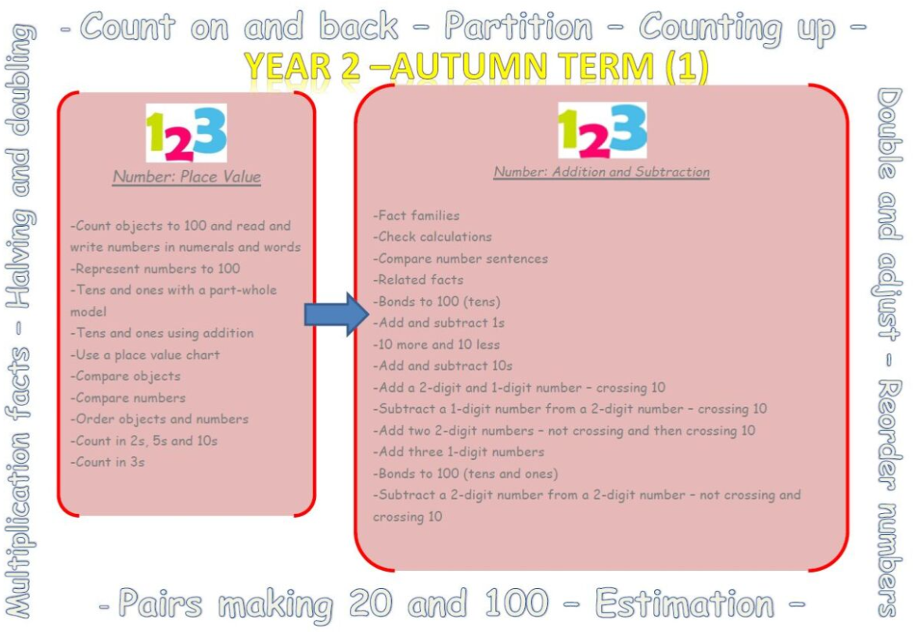
Maths

Slide 10
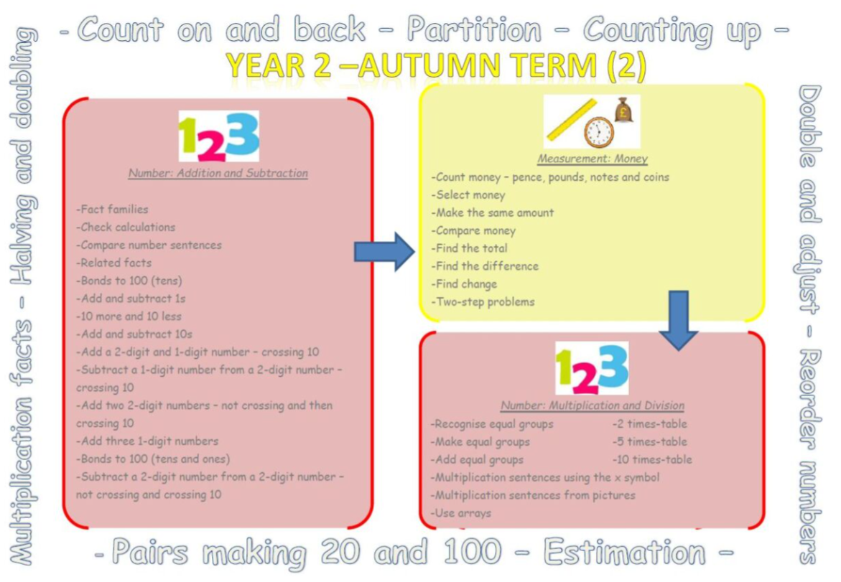

Slide 11
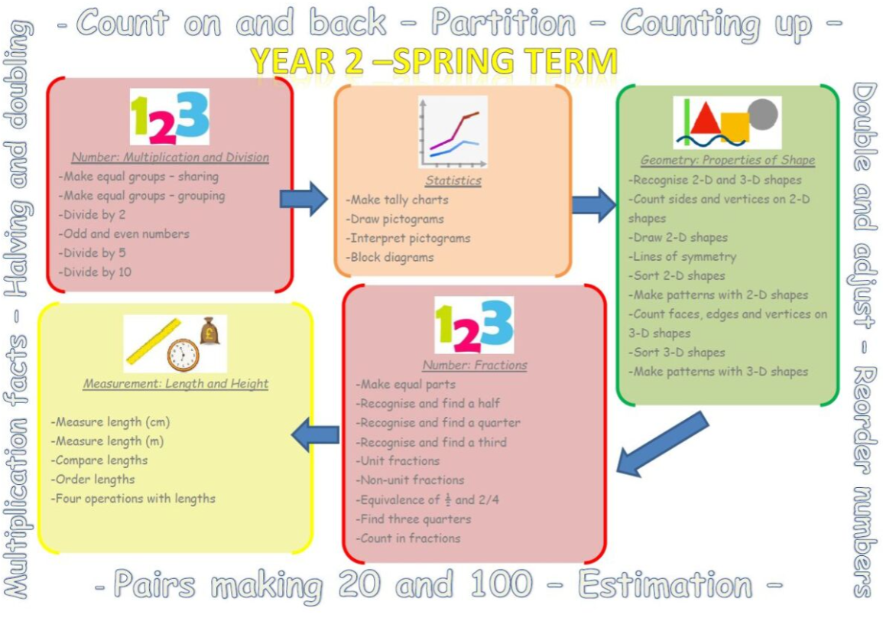

Slide 12
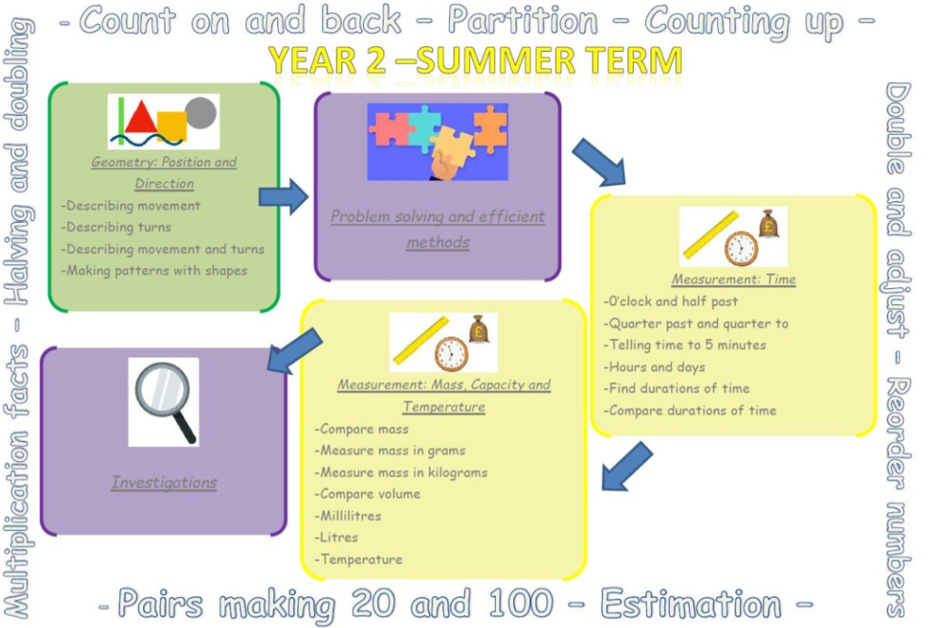

Slide 13
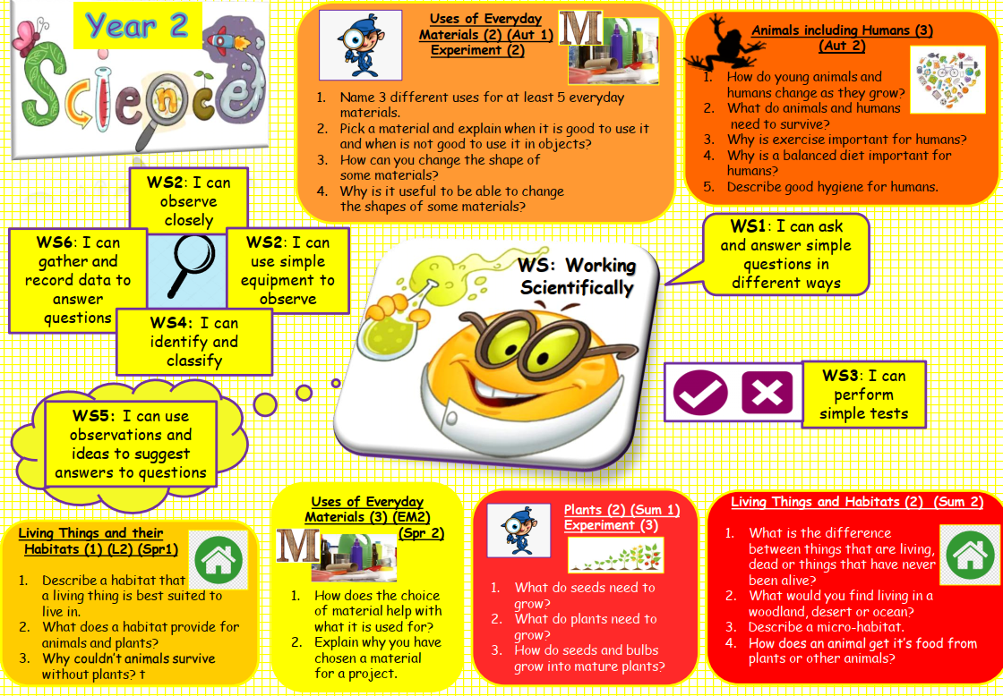
Science

Slide 14
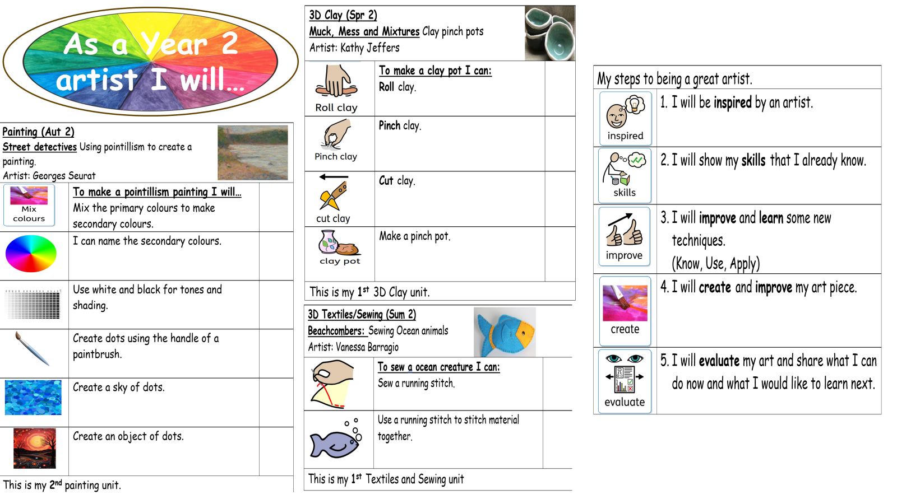
Art

Slide 15
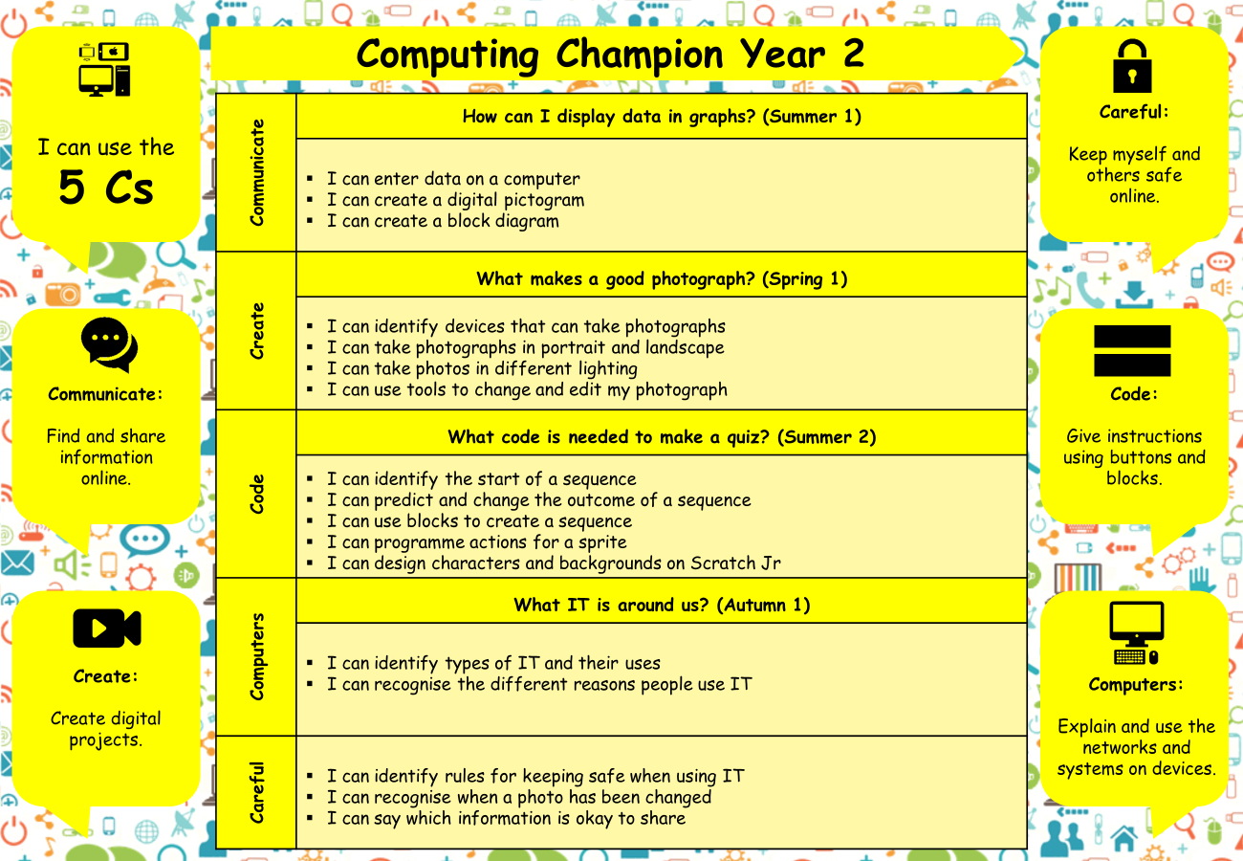
Computing

Slide 16
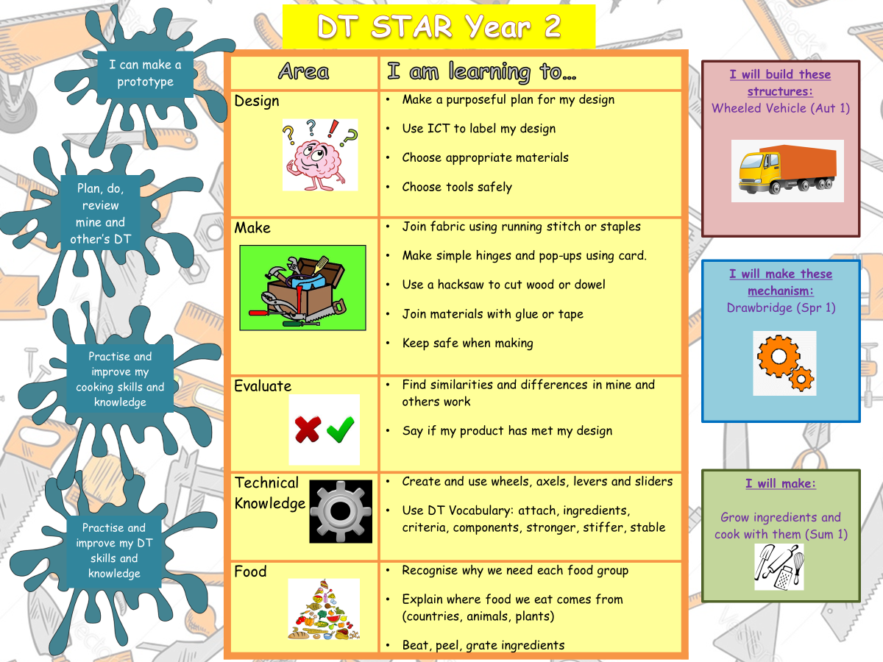
DT

Slide 17
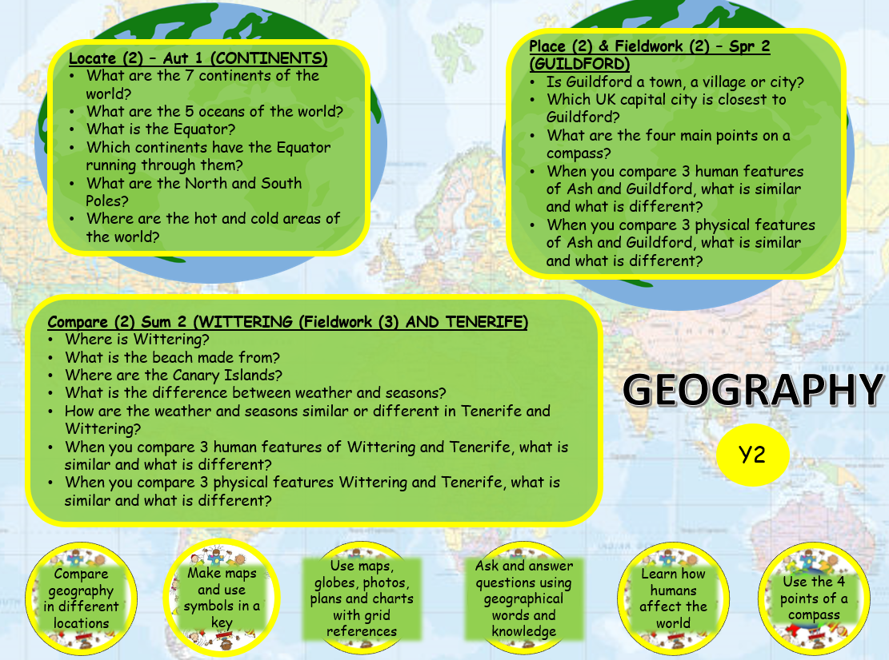
Geography

Slide 18
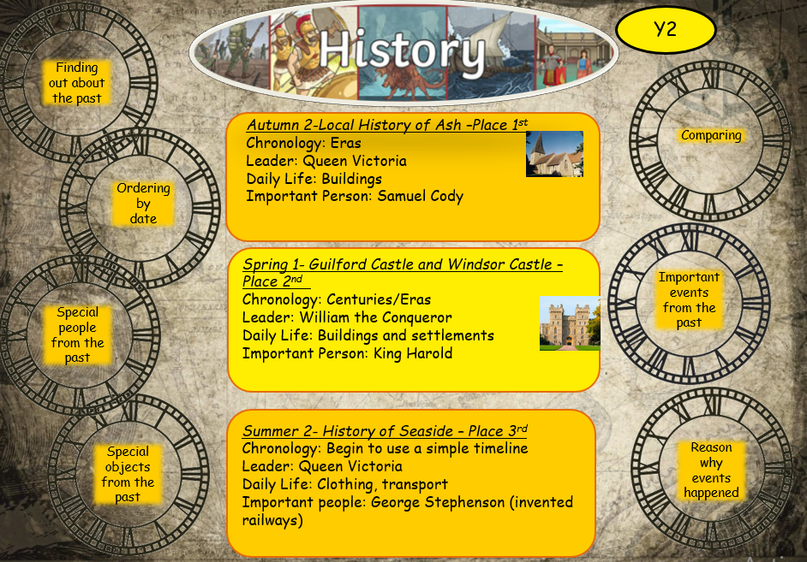
History

Slide 19
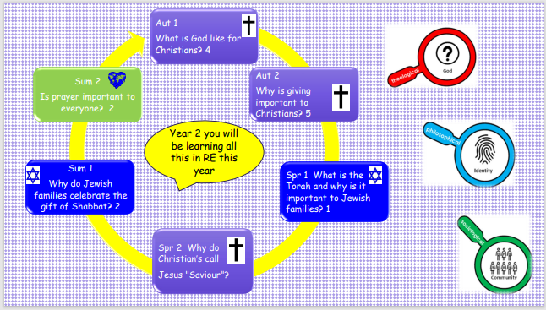
R.E

Slide 20
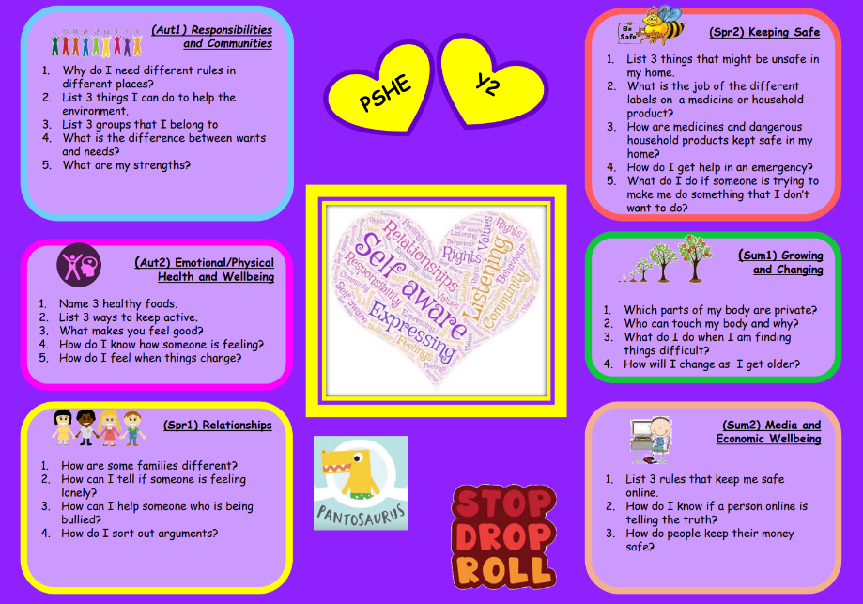
PSHE

Slide 21
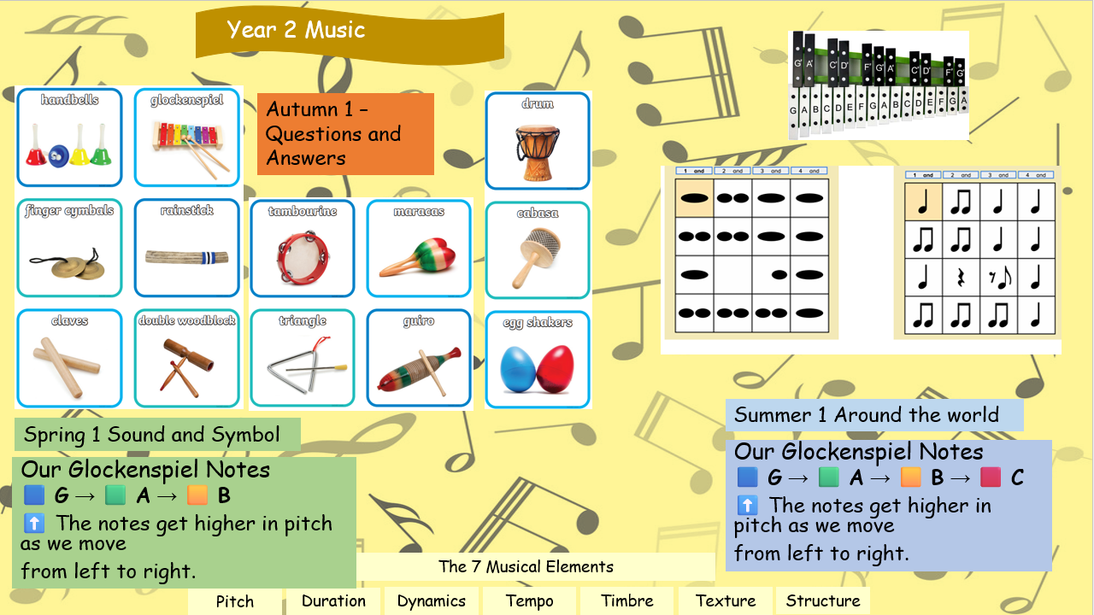
MUSIC

Slide 22
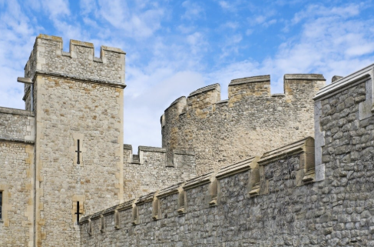
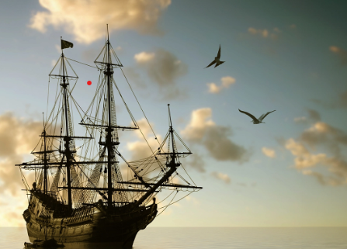




Projects and Novels
Autumn 1 | Autumn 2 | Spring 1 | Spring 2 | Summer 1 | Summer 2
Land Ahoy! | Street Detectives | Towers, Tunnels & Turrets | Muck mess & Mixtures | Scented Garden | Beachcombers
Emily Brown & the Thing (PSHE focus) | The Flower, Tuesday, The Hodgeheg | Gorilla (Author focus A. Browne) Who's Afraid of the Big Bad Wolf | Pumpkin Soup | Amazing Grace | Meerkat Mail

Slide 23
Website link
https://www.ash-grange.surrey.sch.uk/year-2/
We will share work and learning
Marvellous ME
There will be pictures and messages to share your child’s success and achievements each week.

Slide 24


Reminders
Year 2 has PE on Tuesdays and Thursdays
We usually change books on a Tuesday
WOW DAYS
XMAS NATIVITIES
2 x Class assemblies – Friday 9th October (Spring Term tbc)
Trips/Days Out
(Autumn 2)
Street Detectives topic – ASH LIBRARY & ASH MUSEUM & LOCAL AREA WALK
SPRING TERM
Usually start of Spring 2
GUILDFORD BY TRAIN
SUMMER TERM
Tbc BEACH TRIP TO WEST WITTERING

Slide 25
Homework Expectations
Daily reading
Half termly project contribution
White Rose Maths Homework
10 spellings to practise on Spelling Shed

Slide 26
How to keep in touch
Day by day, after school for a quick chat
Progress meetings termly
Book a mutually convenient appointment through the office
Email Year2teacher@ash-grange.surrey.sch.uk

